Slide 1
CMOS Inverter and Ring Oscillators
Assignmet: Experiment( 7)
Due date: Nov 13 2016 (Sunday)
Prepare by studetns: (1) Saisao kham [EE312]
(2) HAORU XIE [EE352]
Instructor: Dr. LiU

Slide 2
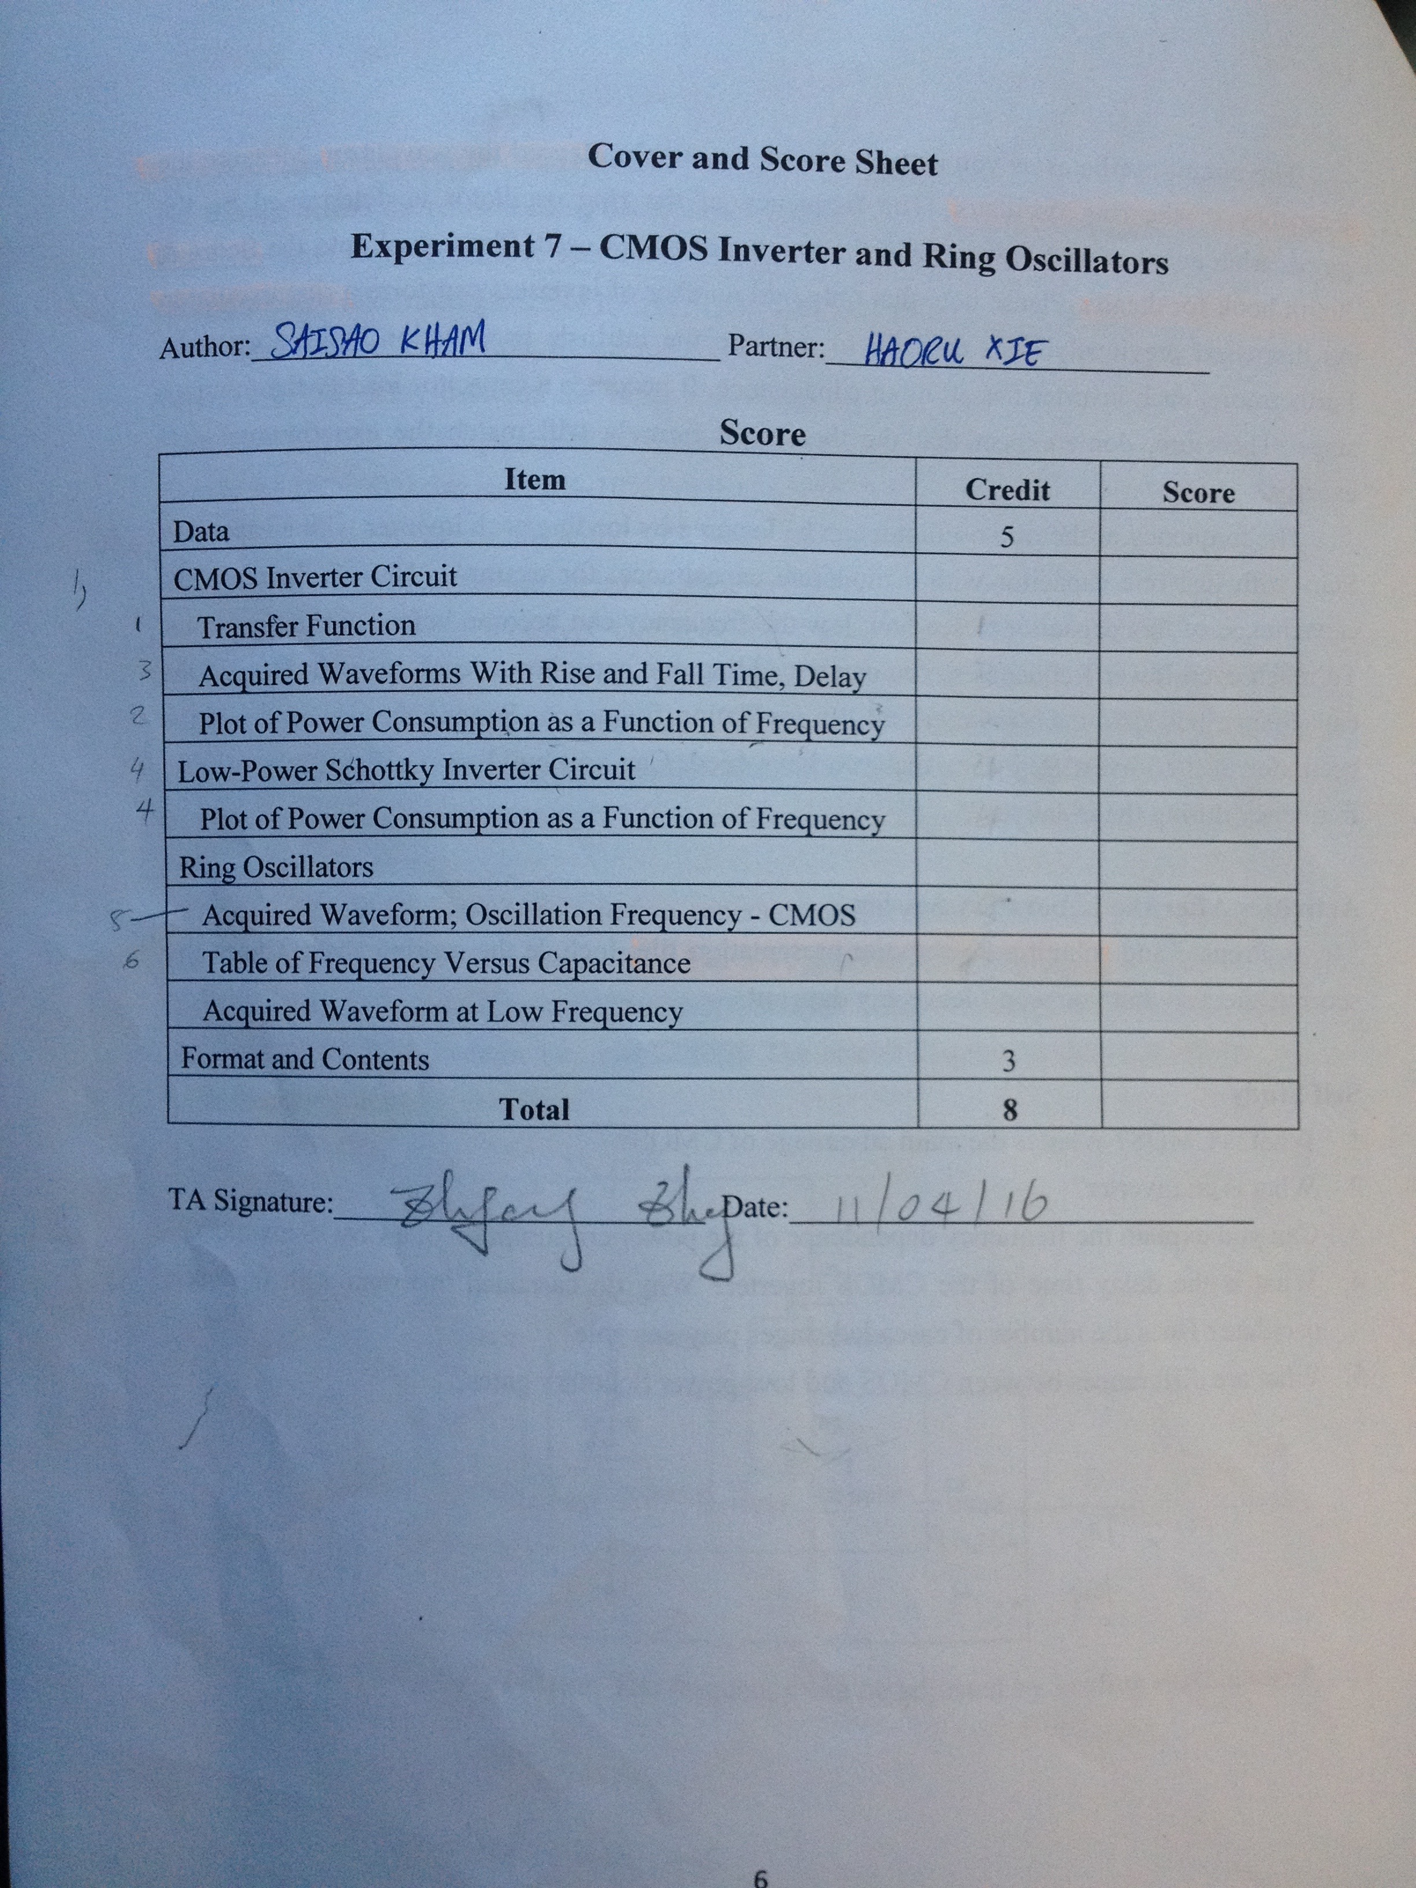
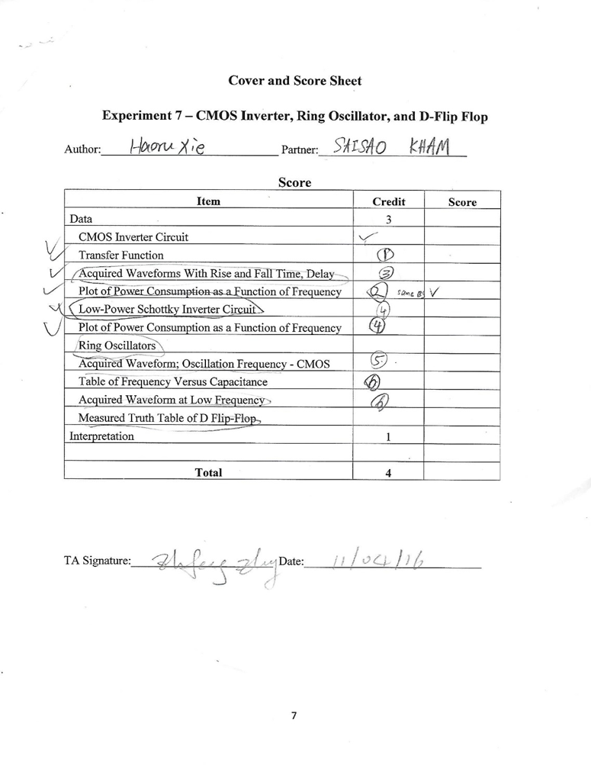
Scoring Sheet
“This report is prepared by Saisao Kham, who is the first author and prepared the original draft of the report,
and Haoru Xie, who is the second author and revised the report.”
“We certify that both team members participated and contributed equally on report preparation.”

Slide 3
Introduction
MOSFET (CMOS) technology is widely used today.
Today’s computers CPUs and cell phones make use of CMOS due to several key advantages.
CMOS offers low power dissipation, relatively high speed
A ring oscillator: composed of an odd number of NOT gates in a ring, output oscillates between two voltage levels, representing true and false.
frequency-stability and power consumption improving of the CMOS ring-oscillator

Slide 4
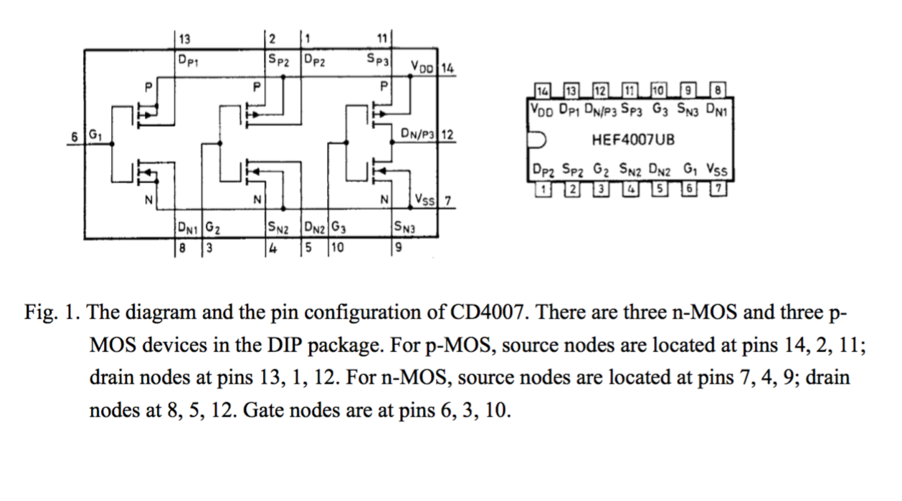
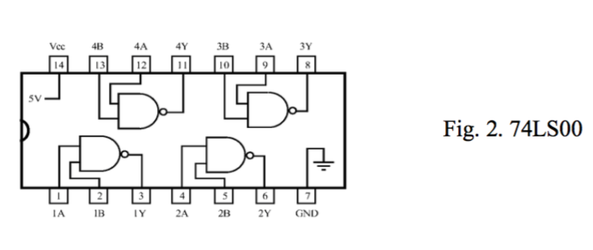
CD4007 Configuration, and 74LS00

Slide 5
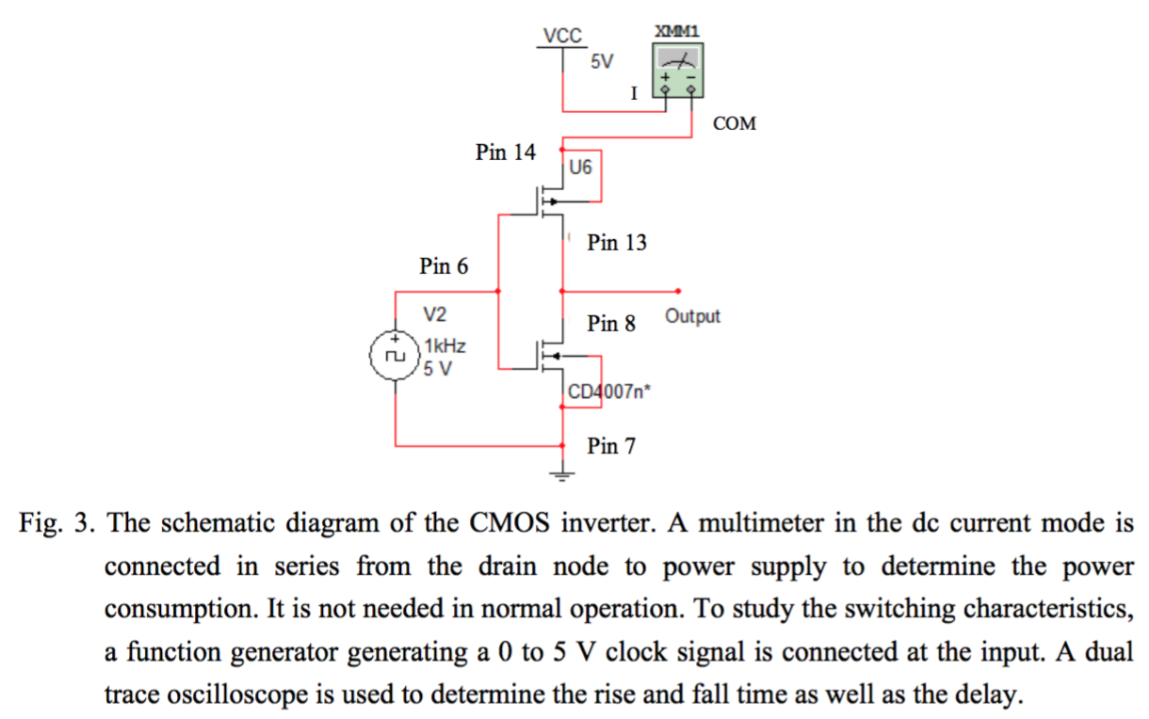
CMOS INVERTER SCHEMATIC DIAGRAM

Slide 6
Abstract
Characterizing basic digital circuits, such as CMOS inverter
Building ring oscillators and adjust frequency.
Building D-flip flop using NAND gates.

Slide 7
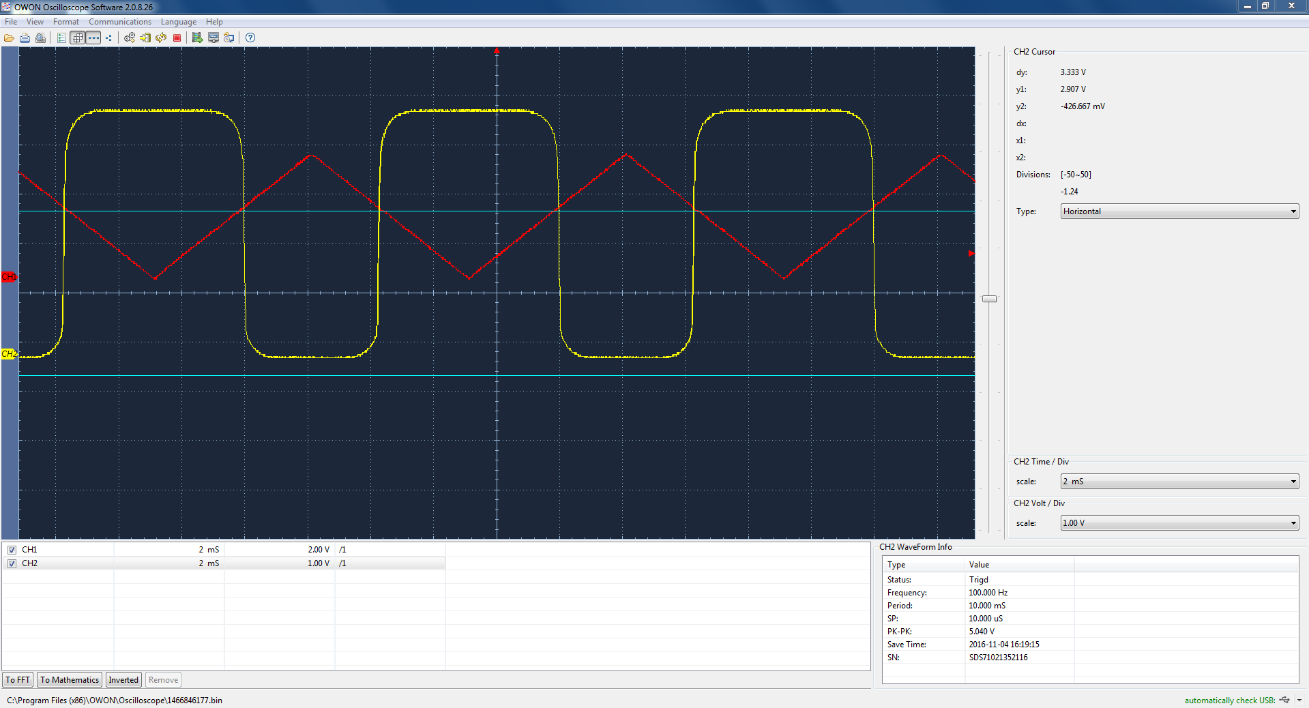
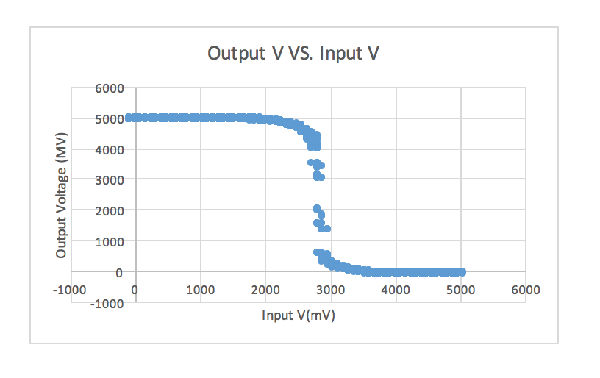
Transfer Function

Slide 8
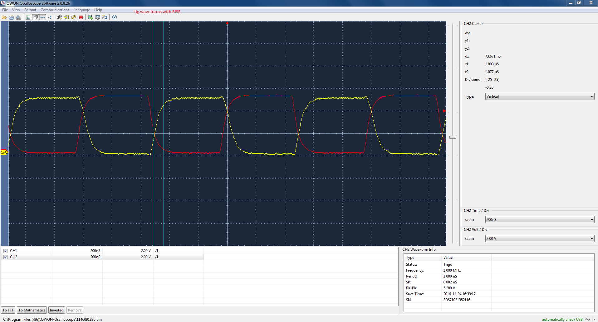

Acquired Waveforms with rise, fall time delay
Rising time delay is 73.671ns
Falling time delay is 80.171ns

Slide 9
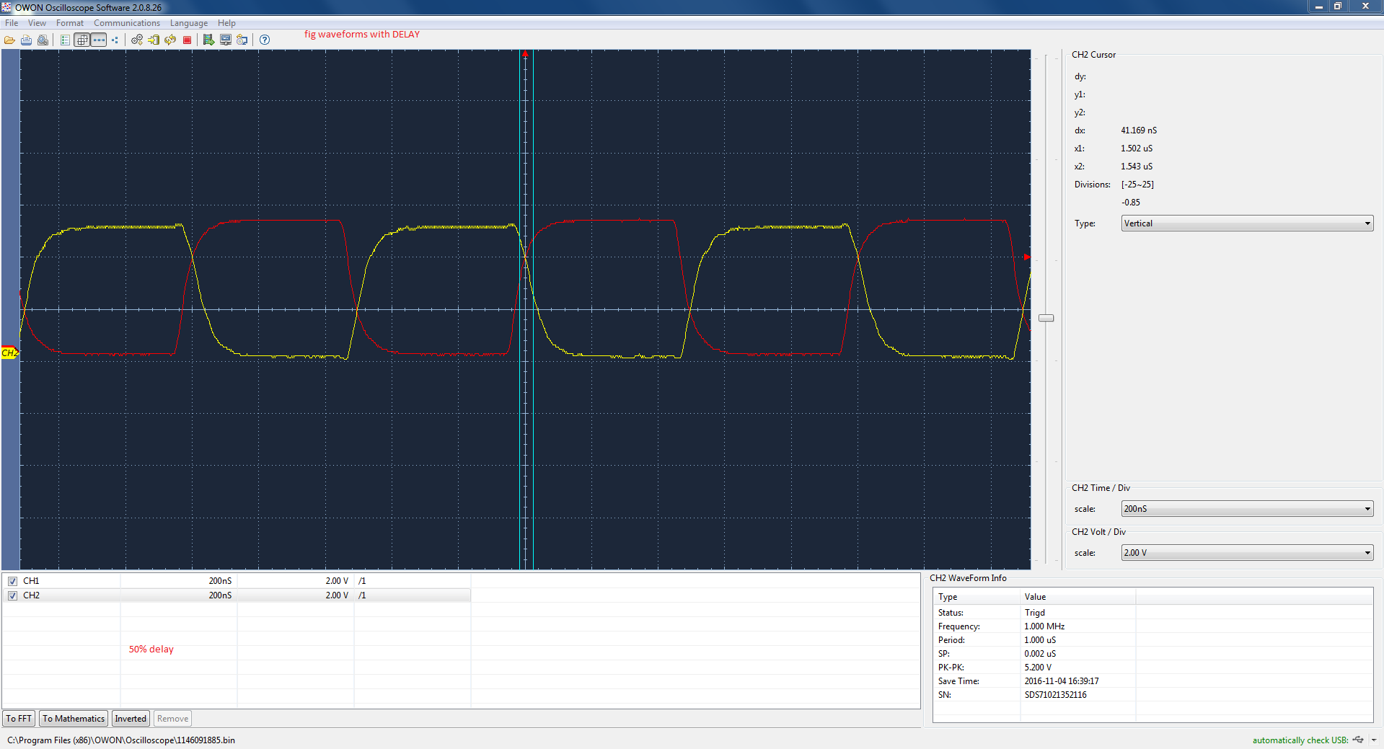
Acquired Waveforms with rise, fall time delay
50 % delay

Slide 10
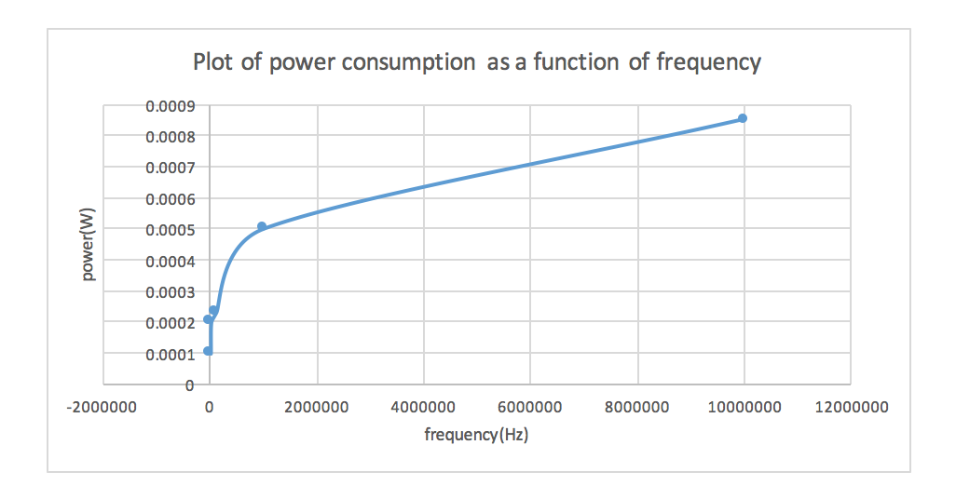
Plot of power consumption as a function of frequency

Slide 11
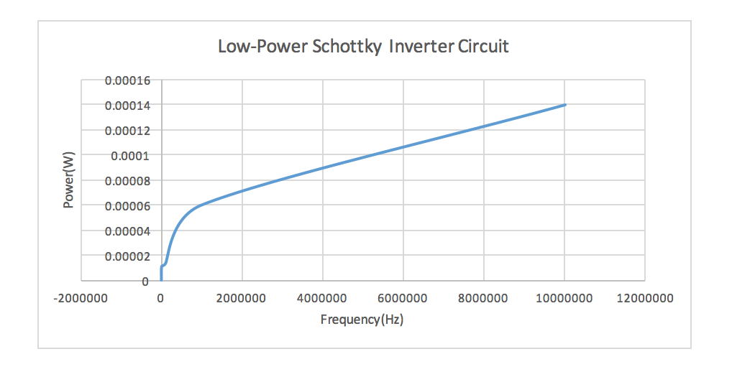
Low-Power Schottky Inverter Circuit

Slide 12
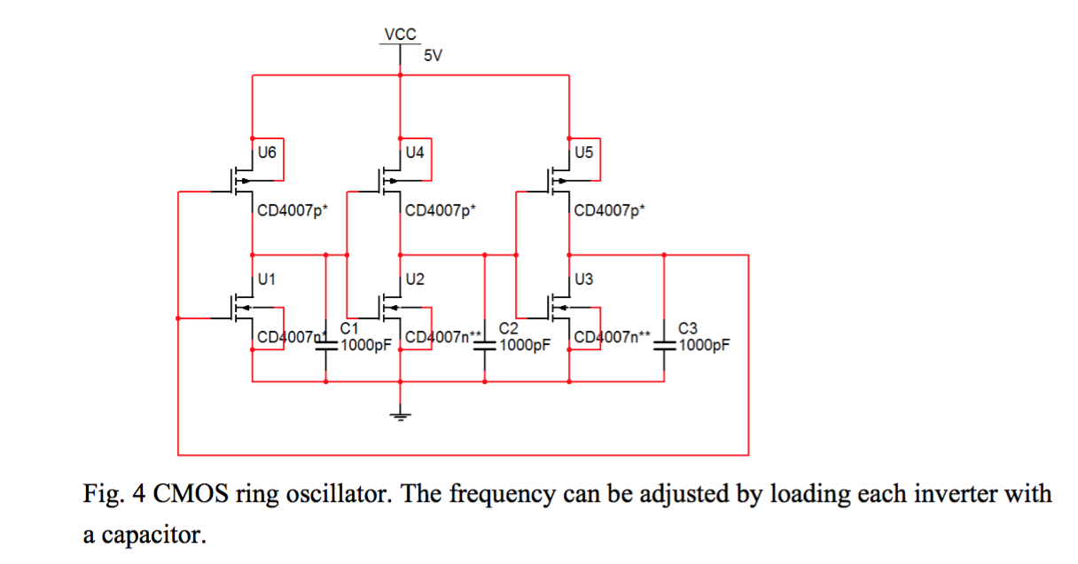
CMOS inverters

Slide 13
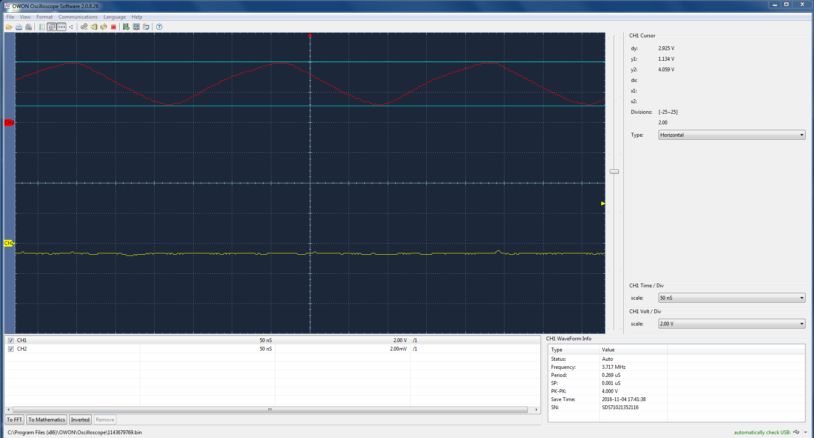
CMOS inverters
Frequency=3.717 MHz

Slide 14
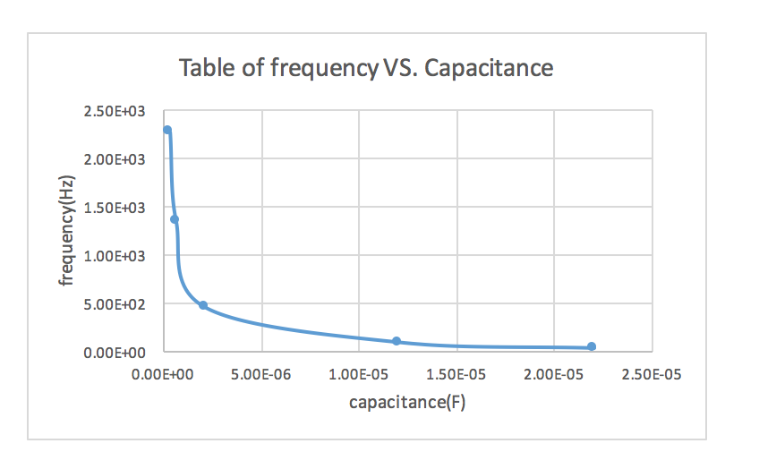
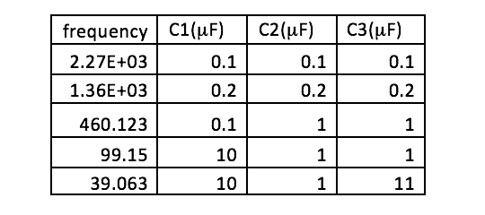
Table of frequency versus capacitance

Slide 15
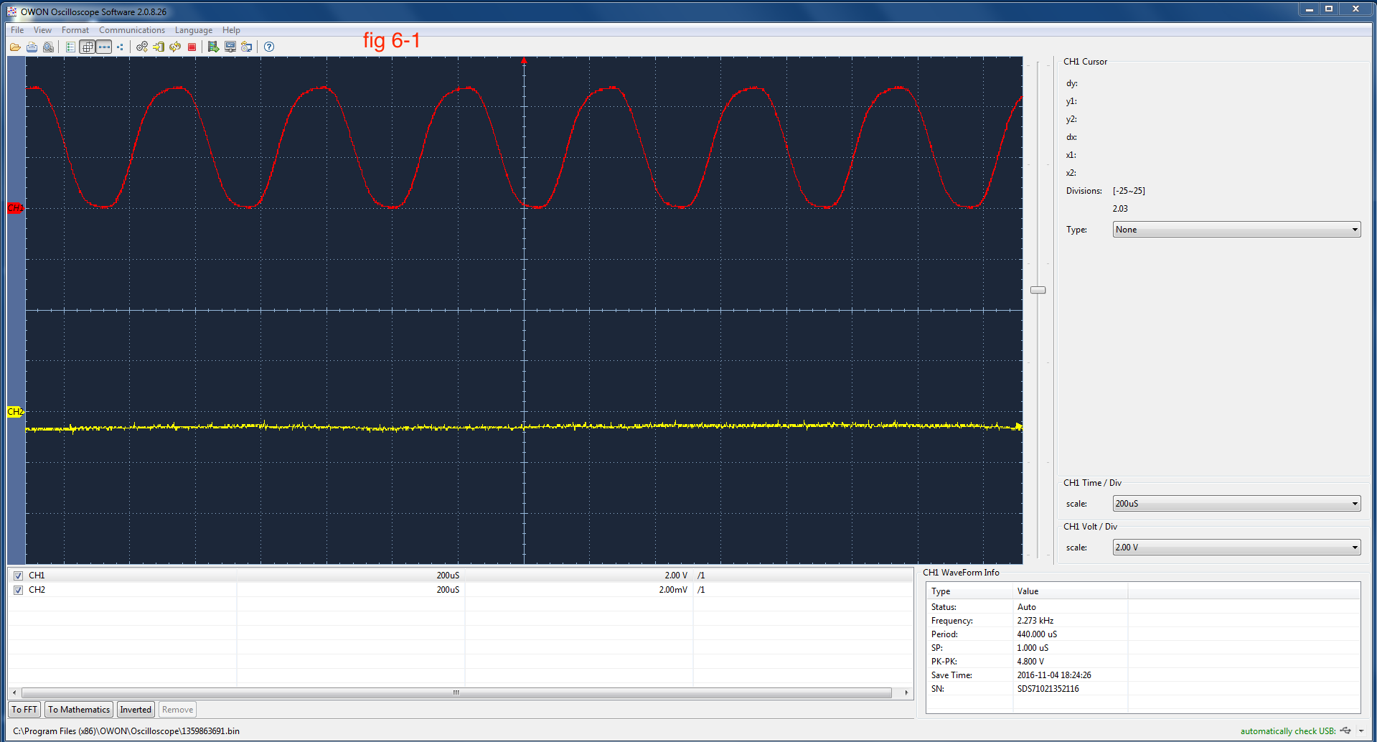
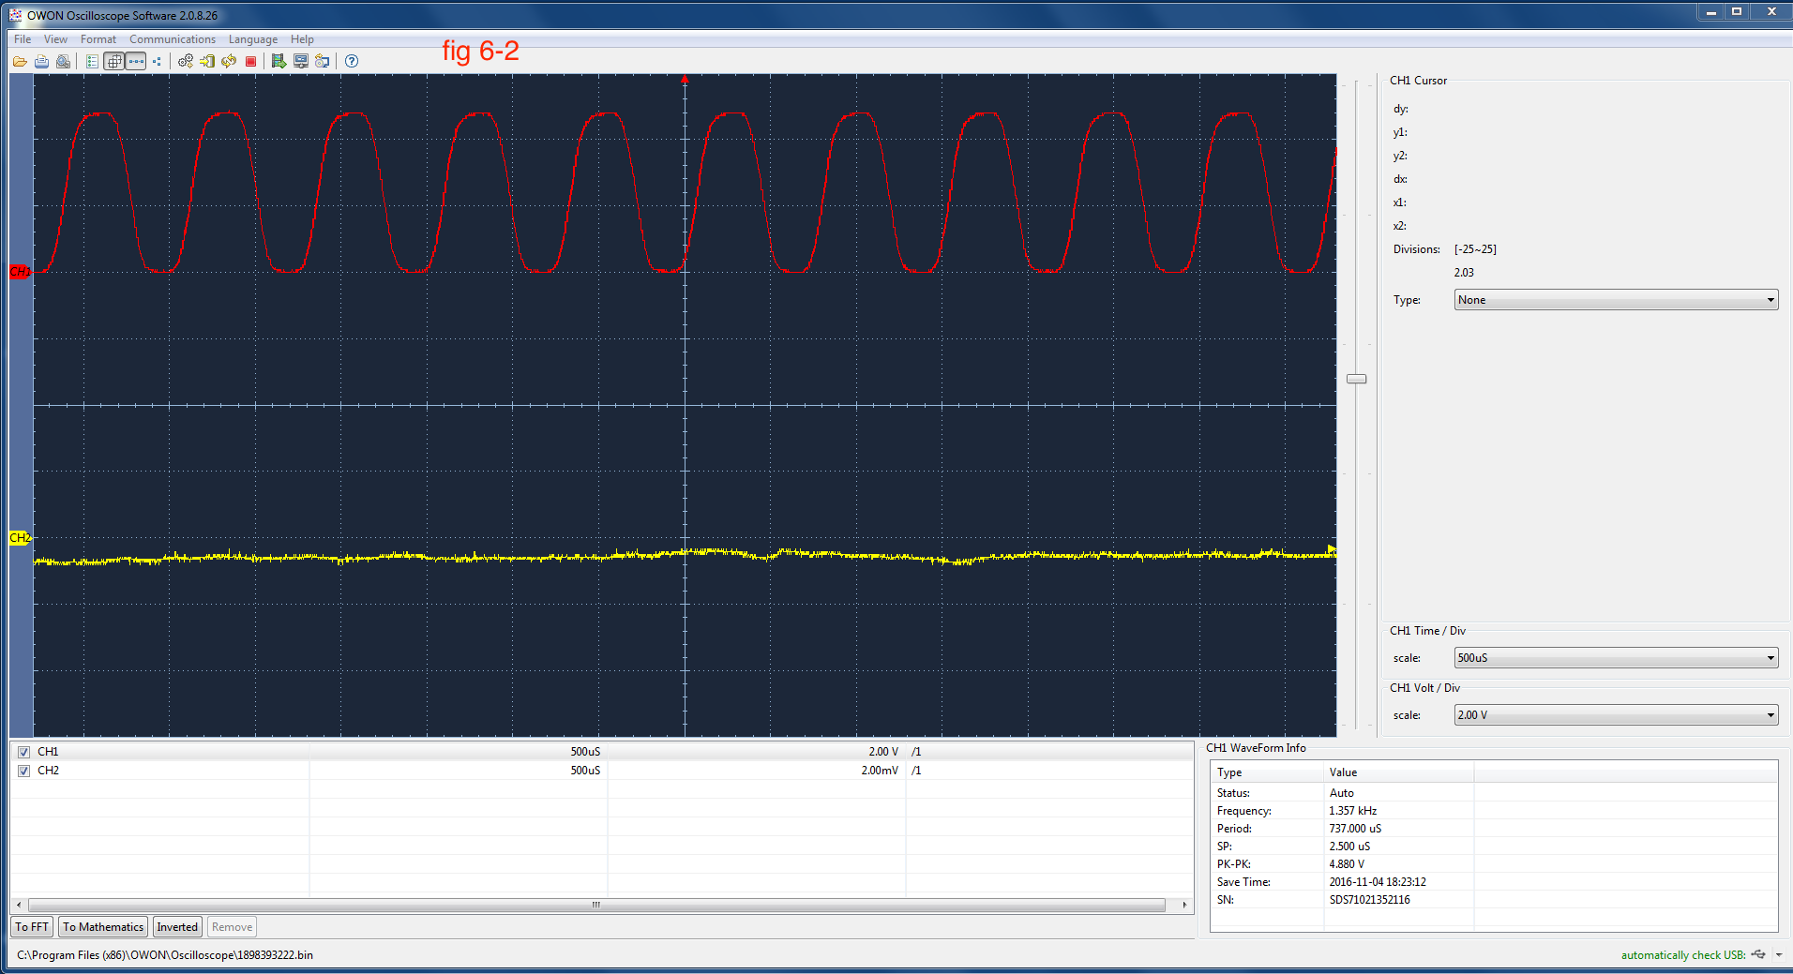
images for the data with the waveform at low frequency.

Slide 16
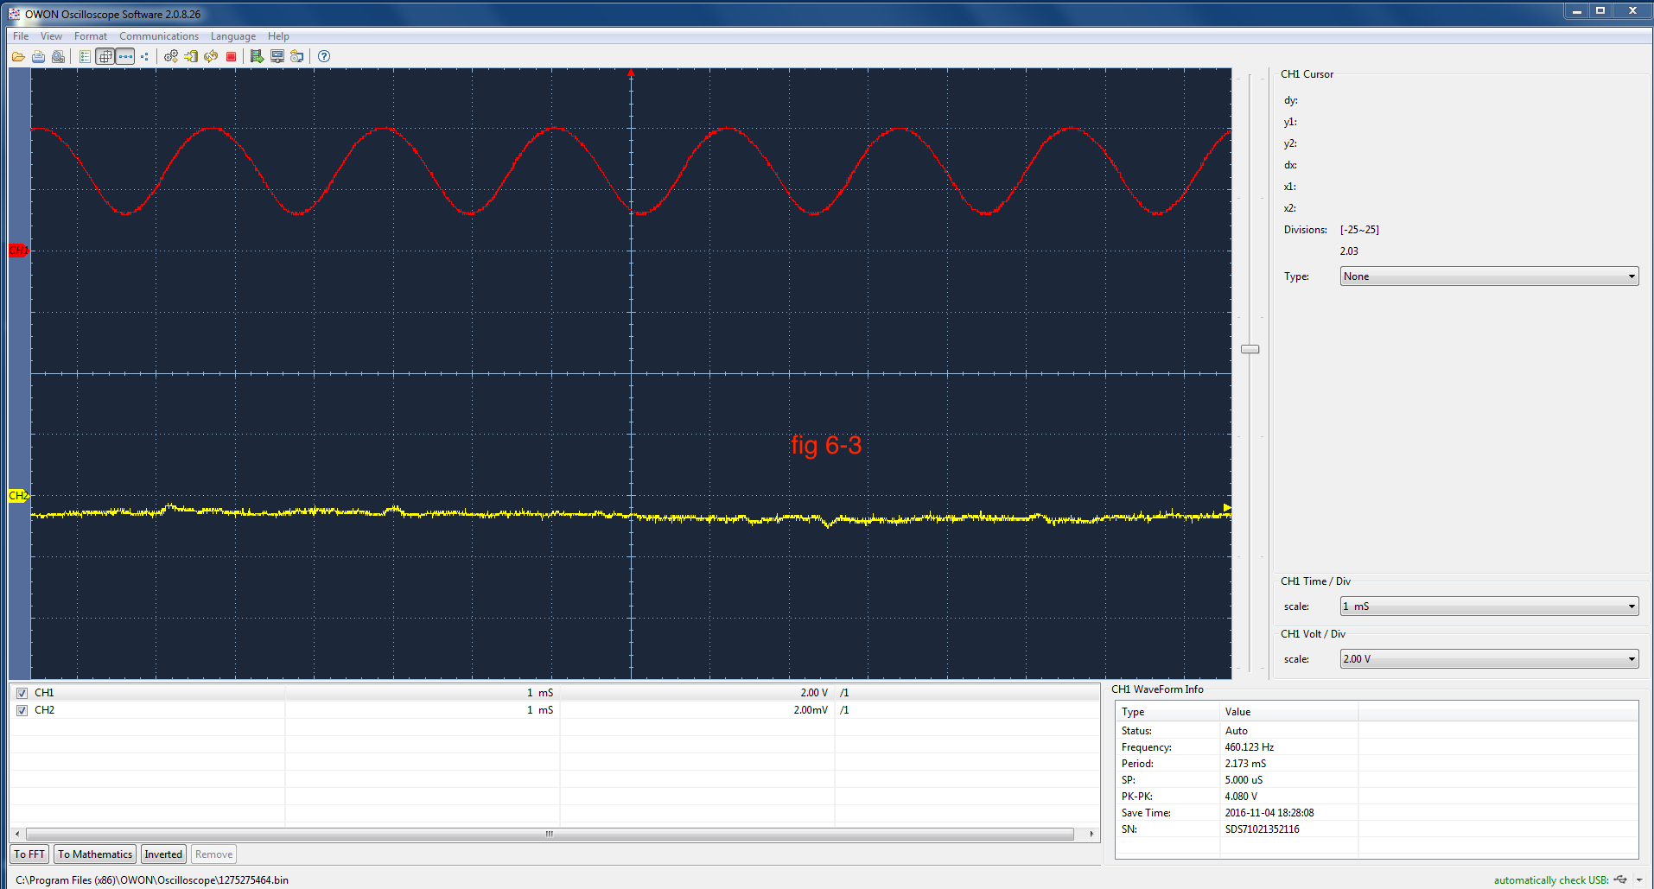
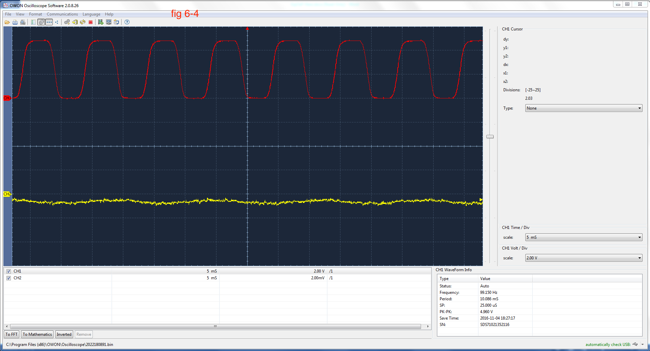
images for the data with the waveform at low frequency.

Slide 17
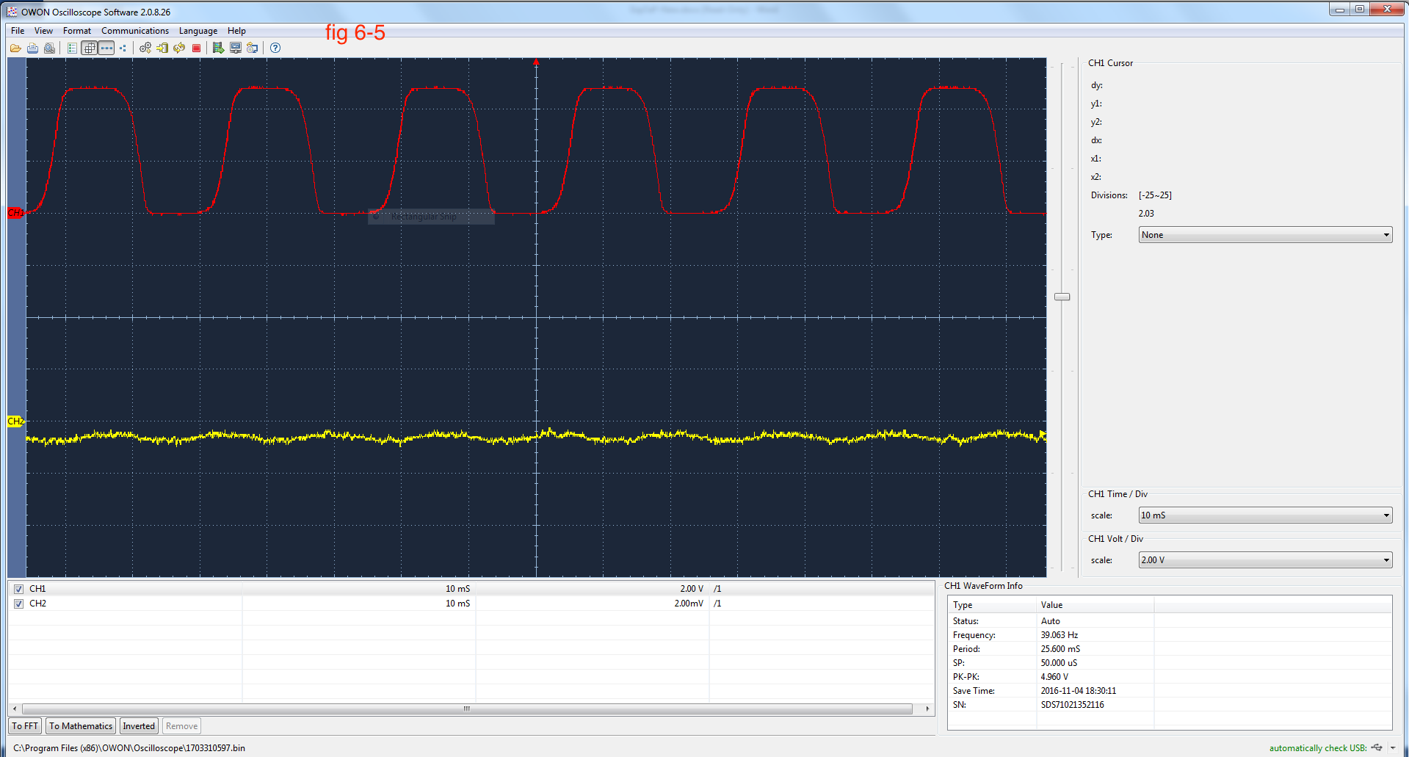
images for the data with the waveform at low frequency.

Slide 18
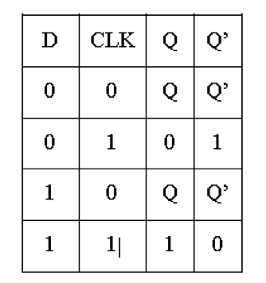
Truth table of D flip flop:
Q only change and clk is 1
When clk is 1 with D is 0, Q is 0.
When clk is 1 with D is 1, Q is 1.

Slide 19
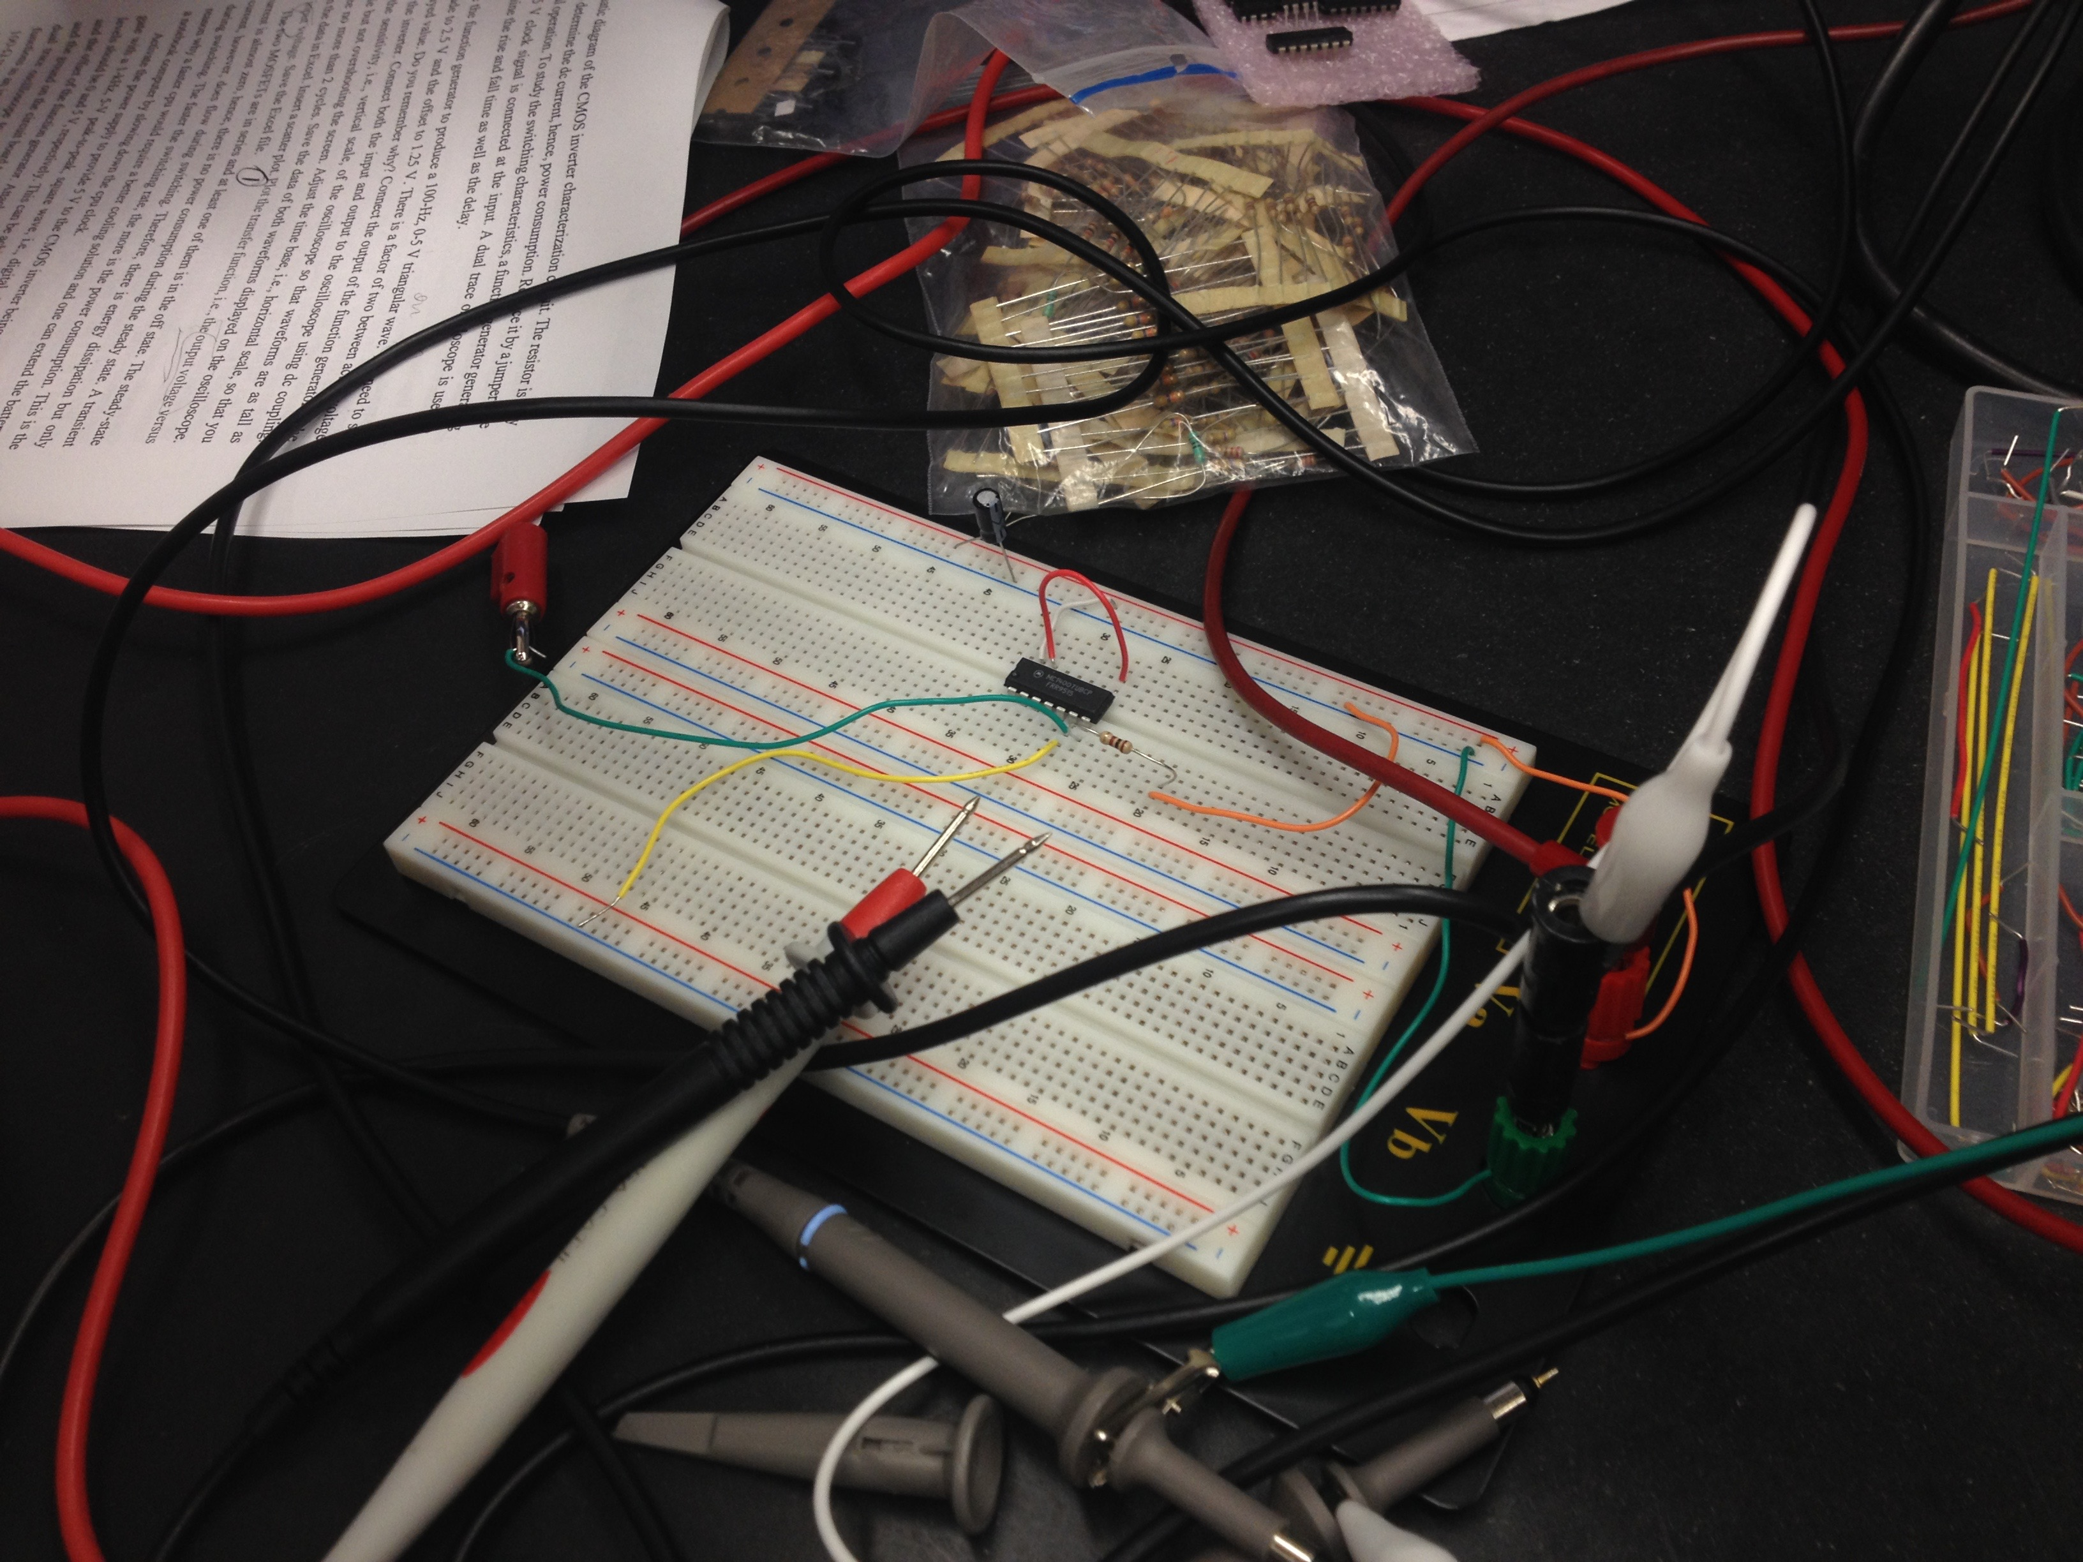
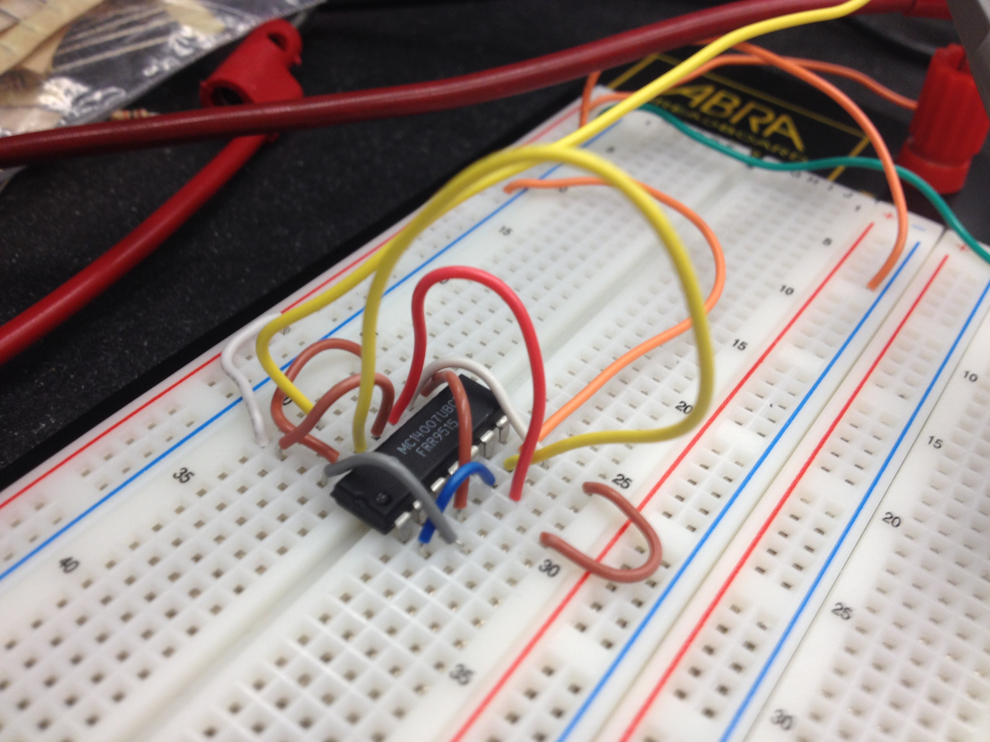
Parts needed: CD4007 CMOS inverter, two 74LS00 IC chips containing low- power Schottky NAND gates Schottky NAND gates

Slide 20
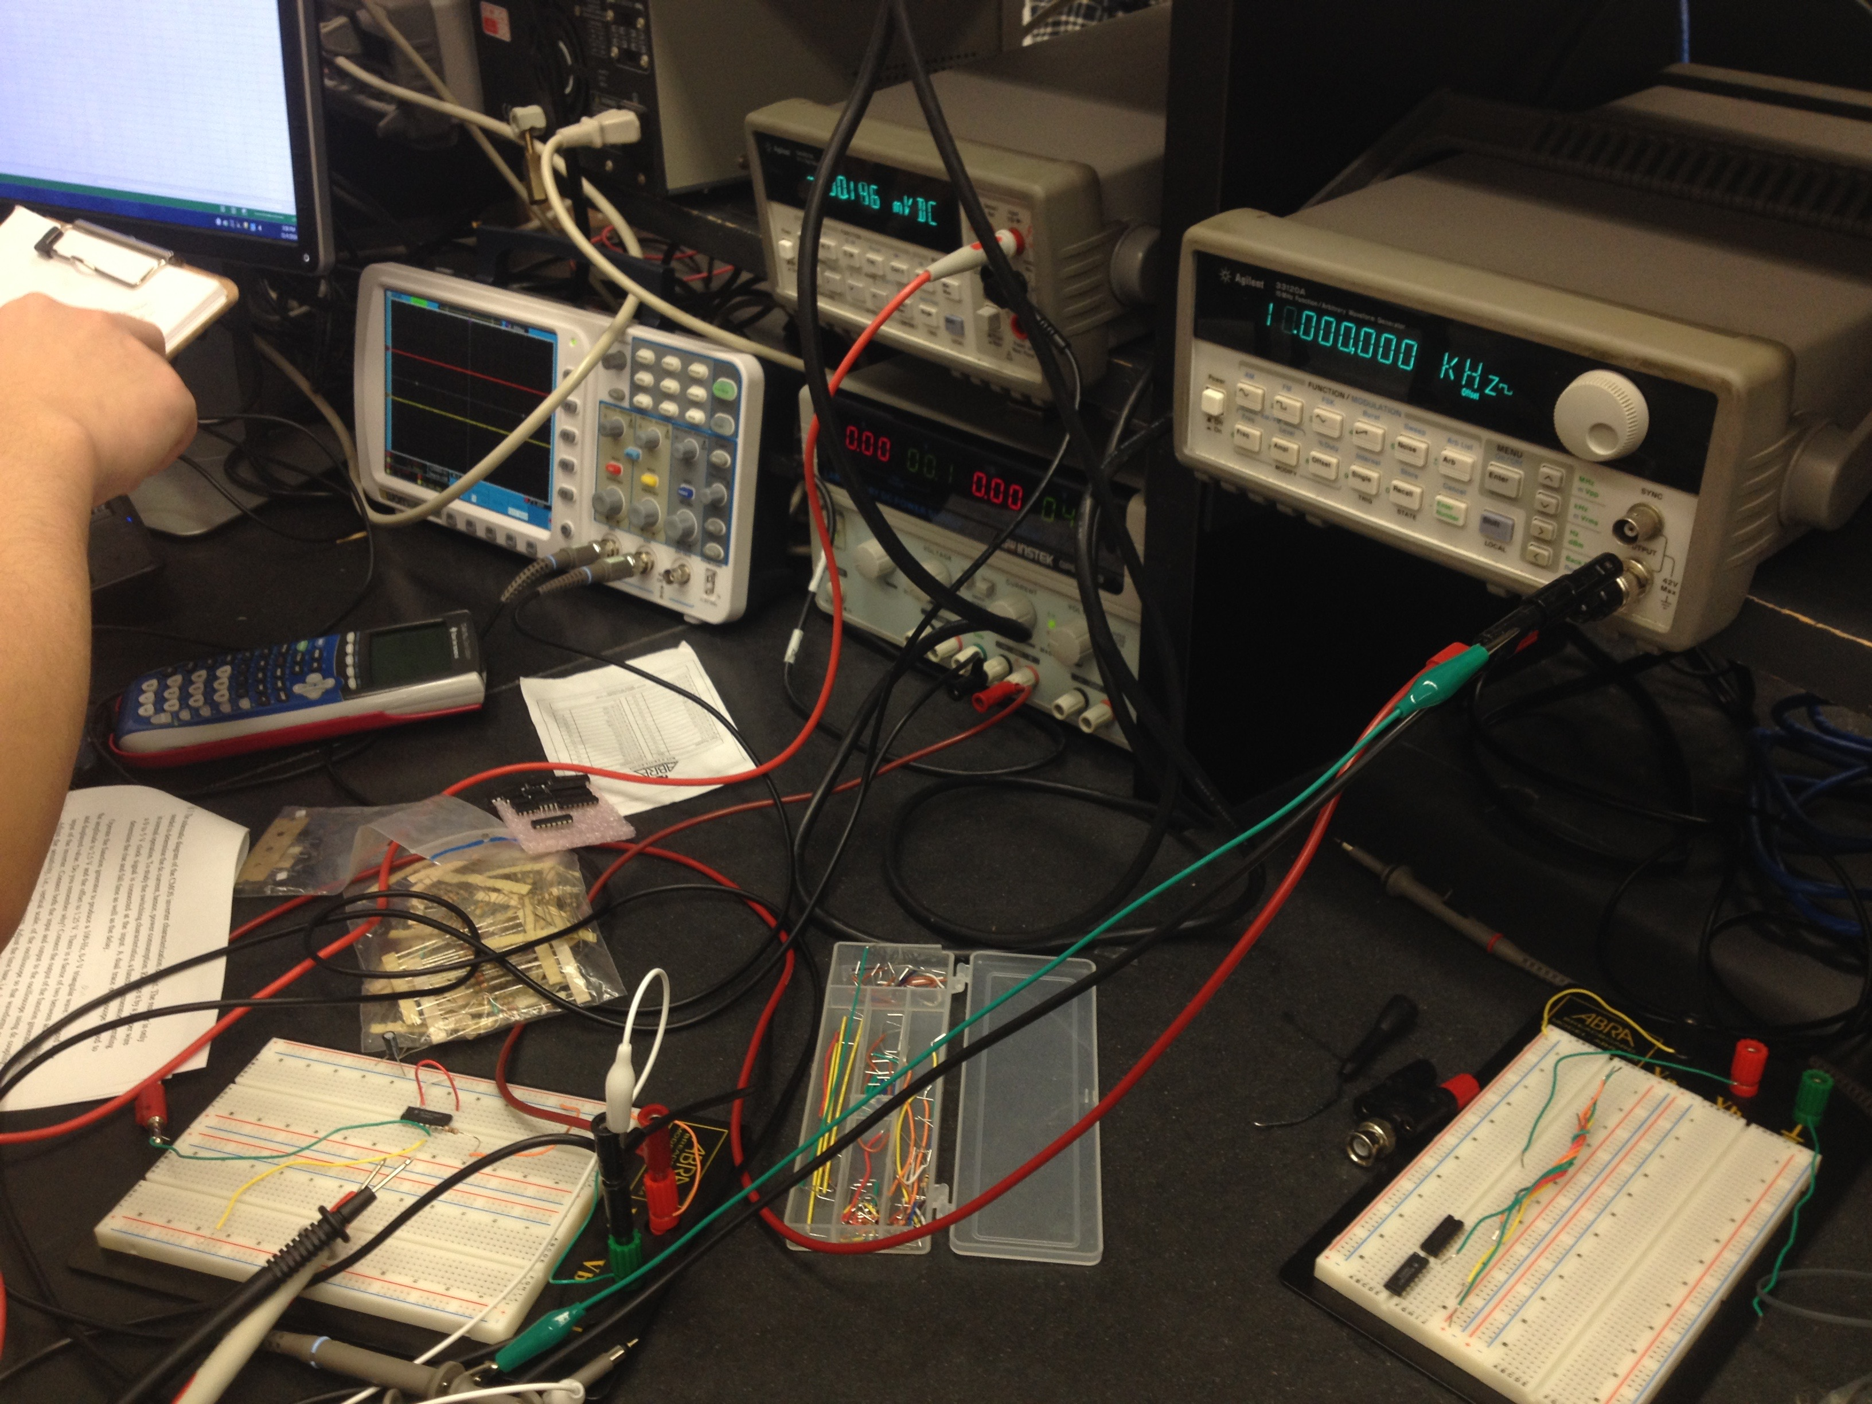
ProcessING images

Slide 21
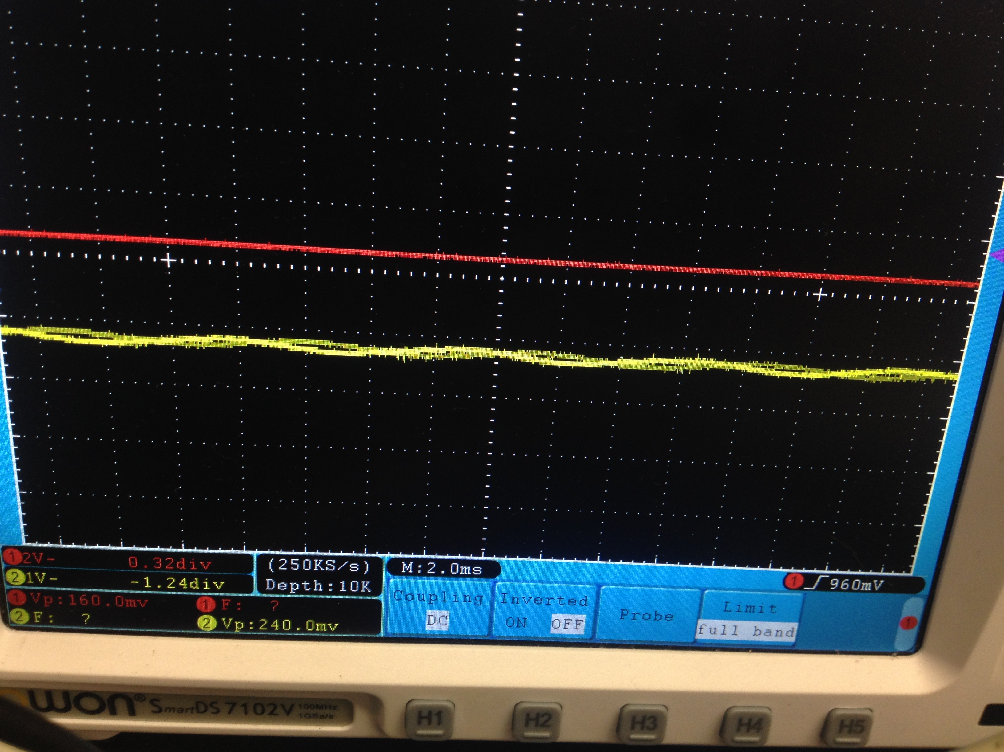
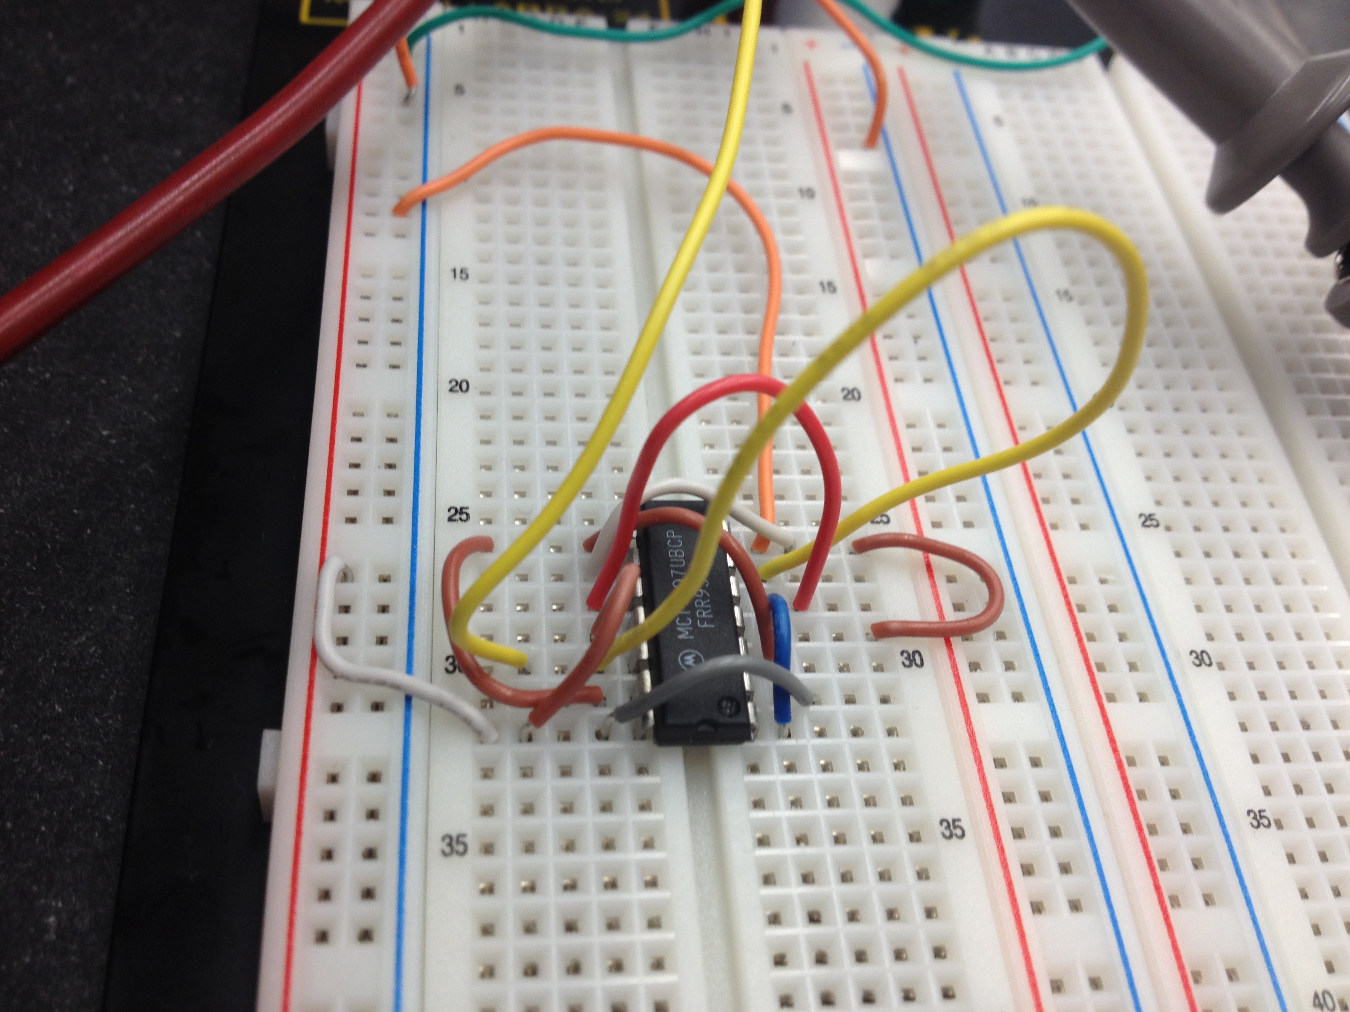
ProcessING images

Slide 22
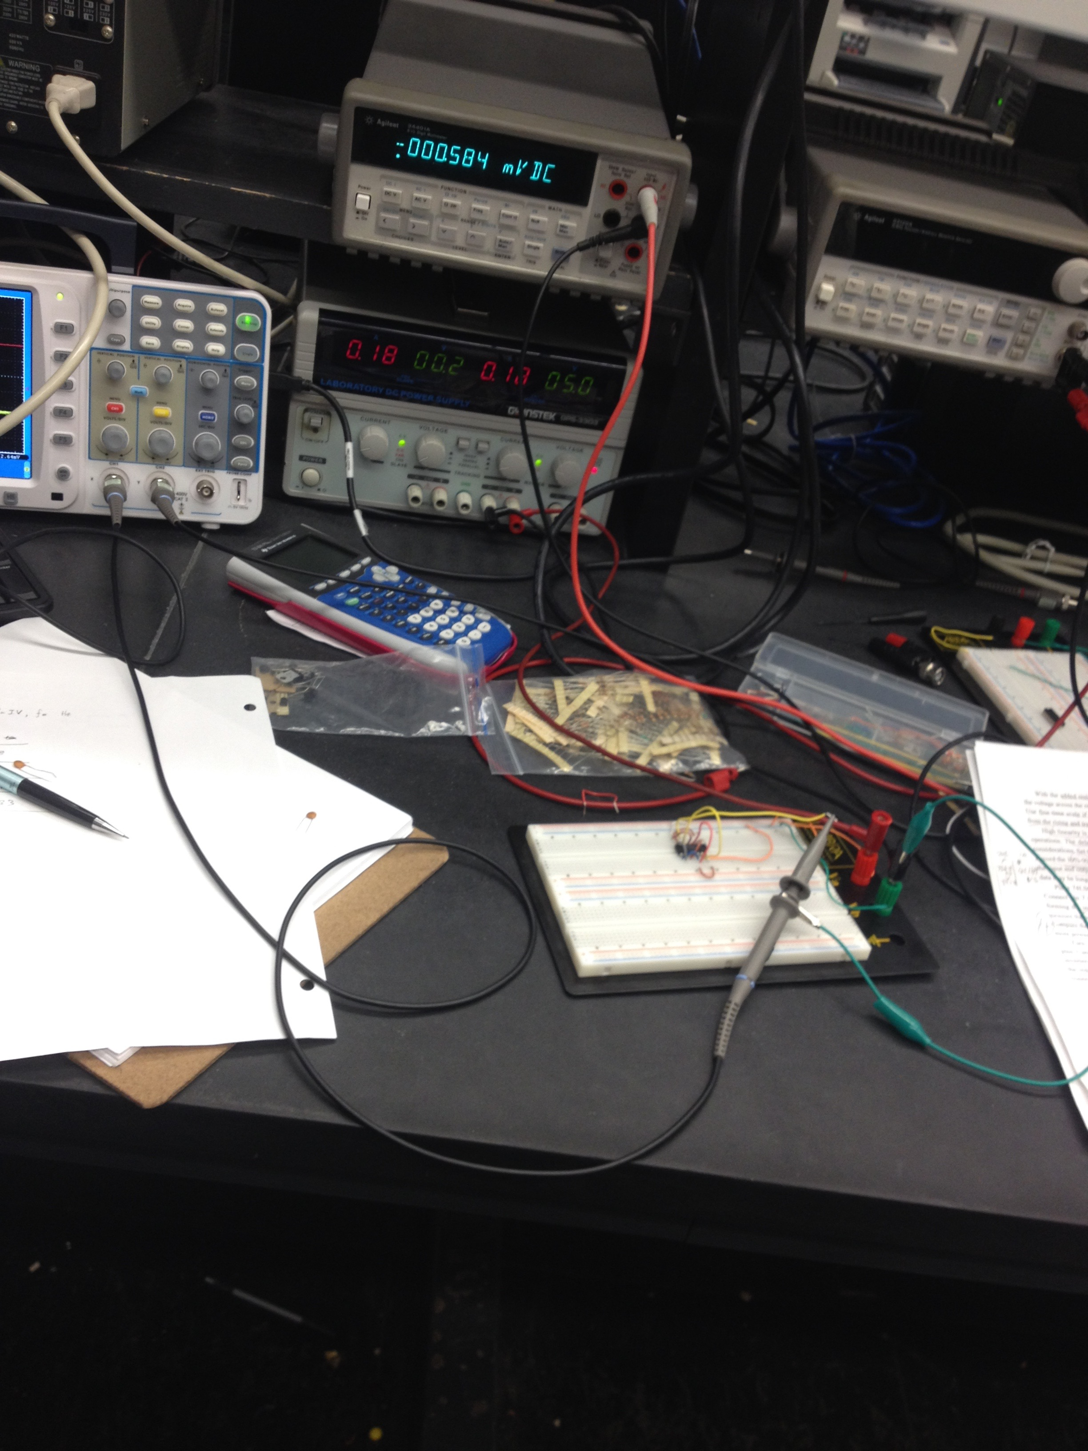
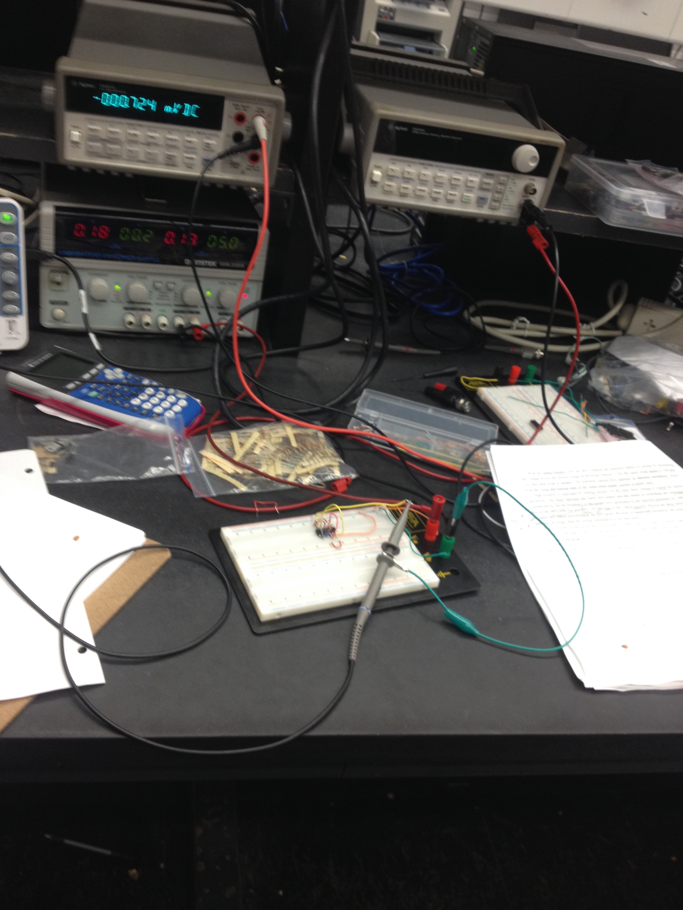
ProcessING images

Slide 23
Discussion
The frequency dependence of the power consumption of a CMOS inverter
(1) Why worry about power?
Heat Dissipation
(2) High End Power Consumption
While you can probably afford to pay for 100-200W of power for your desktop. Getting that heat off the chip and out of the box is expensive.

Slide 24
Discussion
Characteristics of CMOS logic
Rise and fall times are controlled: The rise and falls are usually ramps instead of step functions, and they are 20 - 40% longer than the propagation delays.
Dissipates low power: The power dissipation is dependent on the power supply voltage, frequency, output load, and input rise time. At 1 MHz and 50 pF load, the power dissipation is typically 10 nW per gate
Levels of the logic signal will be essentially equal to the power supplied since the input impedance is so high

Slide 25
Discussion
Characteristics of TTL logic OR low-power Schottky gates
Power dissipation is usually 10 mW per gate
Propagation delays are 10 nS when driving a 15 pF/400 ohm load
Voltage levels range from 0 to Vcc where Vcc is typically 4.75V - 5.25V. Voltage range 0V - 0.8V creates logic level 0. Voltage range 2V - Vcc creates logic level 1.

Slide 26
Conclusion
CMOS gates are very simple.
The basic gate is a inverter, which is only two transistors.
This together with the low power consumption means it lends itself well to dense itegration.
Or conversely, we get a lot of logic for the size, cost, and power.
It refers to how the gates are constructed on the IC. CMOS stands for Complementary MOS (metal oxide semiconductor), which uses uses both PMOS and NMOS (i.e. complementary) to construct the logic.

Slide 27
References
Dr. Liu’s experiment 7 description.
Dr. Liu’s Lecture 7 ppt.
A. S. Sedra and K. C. Smith, "Microelectronic Circuits," 7th Edition 2015. Chap.1 through Chap.7. (ISBN: 9780199339136) ed. Oxford University Press

Slide 28
THE END

